Slide 1
Final Project Update
GEOG 788P – Methods and Models in Spatial Data Analysis
Fall 2021
Kha-Ai Tran
Notes:
Bivariate clustering

Slide 2
Topic
How does the relationship between agricultural health/productivity and temperature change over time?
Primary Outcome: One or more maps illustrating changes over time and potentially predictive model of how agriculture may change in the future if an existing trend in temperature continues over the next several years. Analysis and interpretation will accompany any produced maps.
Potential Alternative (or bonus): How does the relationship between agricultural health (or productivity) and invasive species change over time? In relation to temperature or another climate change metric?
Notes:
Spatial analysis of agricultural productivity and vegetation/land cover across the United States with relation to changes in air or surface temperature over time.

Slide 3
Background
Climate change has and will have significant impact on agriculture.
Temperature and precipitation especially can have significant impact on annual crop yield.
In 2017, 40% of land in the U.S. were farms. This is a significant proportion and understanding climate change impacts on agriculture is critical to a major sector of the U.S.
Additionally, many invasive species have also been known to expand their territory and footprint, as well as grow in volume with the increase in globalization as well as changing climate.
Changing climates change the ecosystem, sometimes detrimental to native species by pushing them out of their natural habitats (whether through migration or disease and death) and creating habitats supportive of growing invasive species.
Invasive species can destroy forests, damage crops, spread diseases (some of which can devastate croplands), and more.
Notes:
https://www.nass.usda.gov/Publications/Highlights/2019/2017Census_Farms_Farmland.pdf
https://nifa.usda.gov/topic/invasive-pests-and-diseases

Slide 4
Data
Vector
Points
Polygons
Table
CSV
TXT

Slide 5
Data
 | Data Type
Source | Raster | Vector | Table
NOAA Climate data
USDA Agriculture data
Cropscape Agriculture data
U.S. Forest Service Invasive Species data
U.S. Bureau of Land Management Land Use data
Explanatory variable
Response variables
Response variable
Explanatory and response variable
Response variable

Slide 6
Tools
Geopandas, Folium, PyProj, NumPy, Pandas, Matplotlib
GeoRasters (for raster datasets)
statsmodels

Slide 7
Data Updates
Datasets have different spatial units → data processing needs to be done before analysis:
Determine optimal spatial scale for analysis
Table and spatial joins
Focus on a specific region if necessary depending on data availability
UPDATE #2:
Cleaned up data
Using data for years since 1960 (climate change data needs longer timescale, and 1960 is the earliest data collection for most of the datasets collected)
Exploring data; descriptive statistics

Slide 8
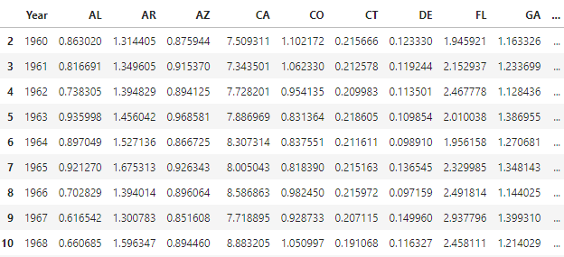
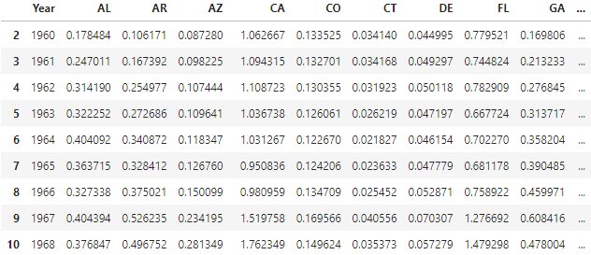
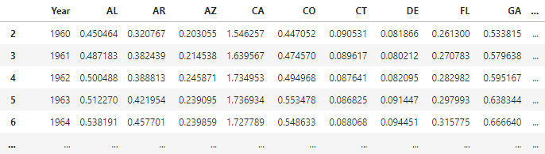
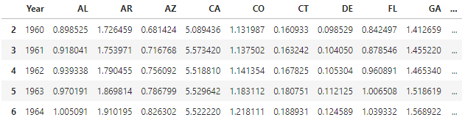
Data Exploration
Crop output
Pesticide Input
Livestock output
Energy Input

Slide 9
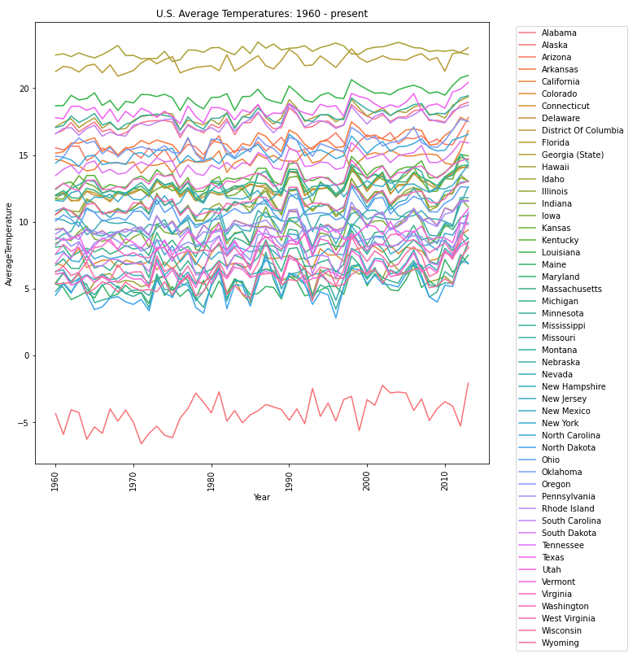
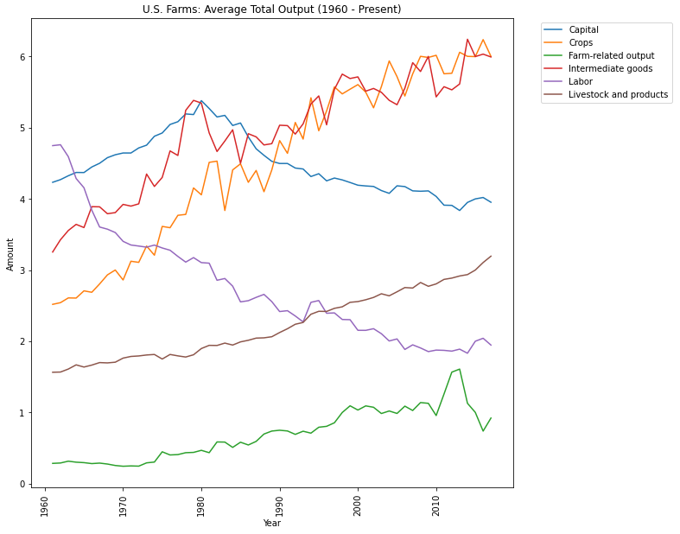
Data Exploration
Advances in technology, automation

Slide 10
Data Analysis
Data cleaning and processing
Exploratory regression analysis on relationship of vegetation, agricultural productivity, and land use against climate change data (temperature as the beginning metric)
Exploratory regression analysis on relationship of agriculture attributes and invasive species territory (focus on amount of area covered by all relevant invasive species); potentially incorporating bivariate analysis
Cluster or optimized hot spot analysis on specific attributes of interest depending on results of exploratory regression analysis (digging deeper into statistically significant variables)

Slide 11
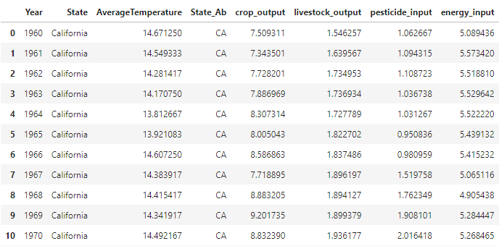
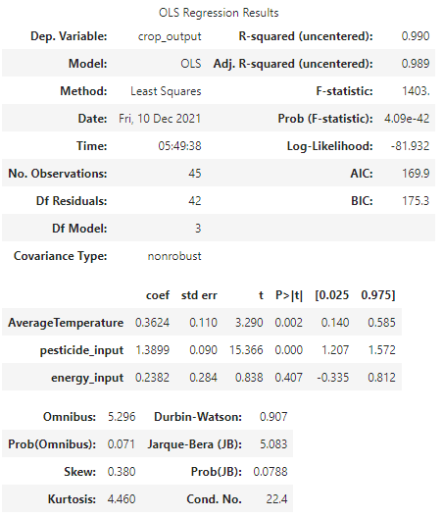
Data Analysis
Ordinary Least Squares (OLS) - California:
Average Temperature and Pesticide Input appear to be statistically significant influences on crop output; energy input not so much.
High r² for this model suggests high correlation between crop output and independent variables.

Slide 12
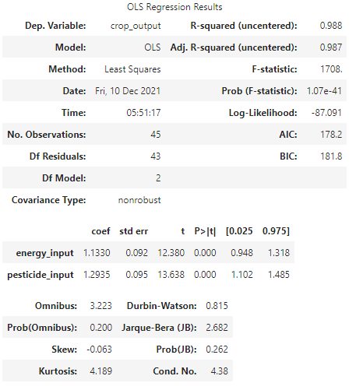
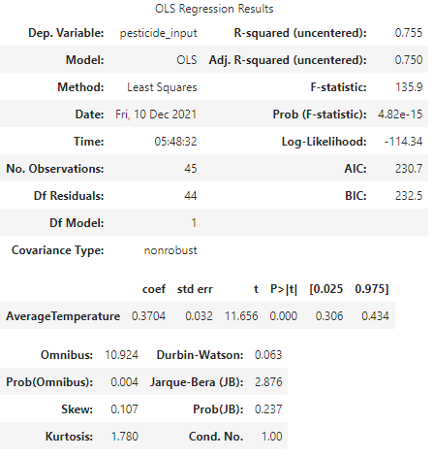
Data Analysis
Interestingly: When Average Temperature is not included in the model, energy input becomes statistically significant.
When looking at pesticide input as a dependent variable, it appears to be relatively highly correlated with average temperature.
Ordinary Least Squares (OLS) - California:

Slide 13
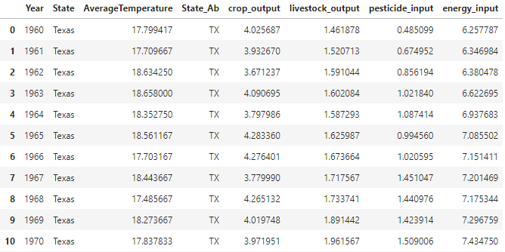
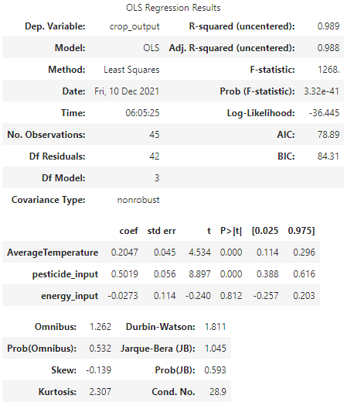
Data Analysis
Ordinary Least Squares - Texas
Average Temperature and Pesticide Input appear to be statistically significant influences on crop output; energy input not so much, like California.
Coefficient for energy input is opposite that of California – why?
High r² for this model suggests high correlation between crop output and independent variables.

Slide 14
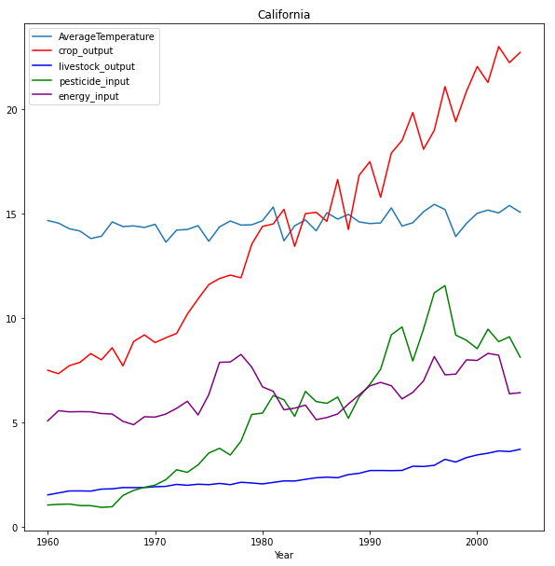
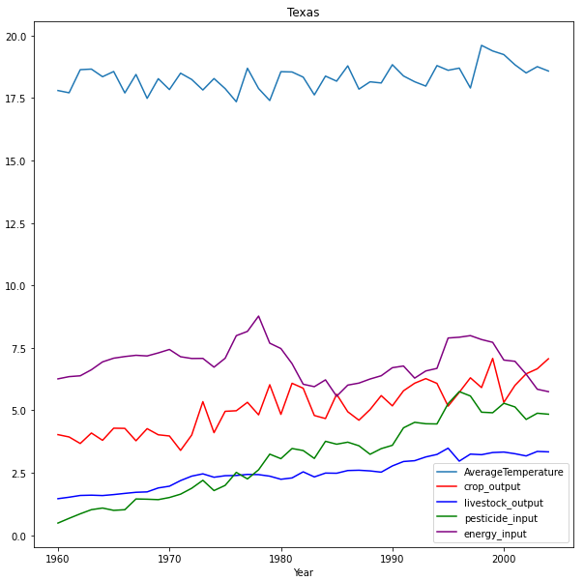
Data Analysis
Examples and Comparisons
Relationship between energy input and crop output is different for California and Texas.
Behavior for pesticide and energy inputs are also different between the states.

Slide 15


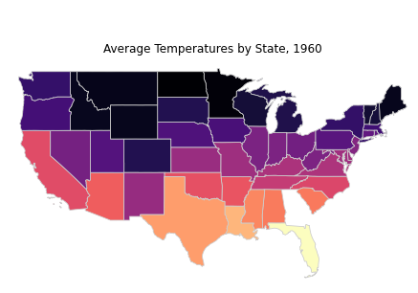
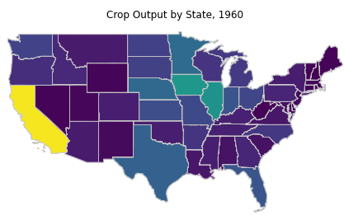
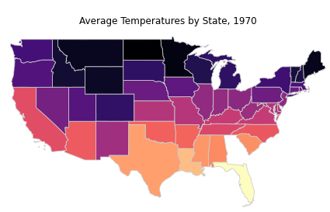
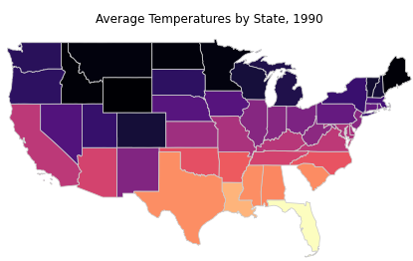
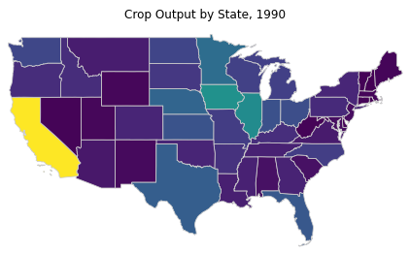
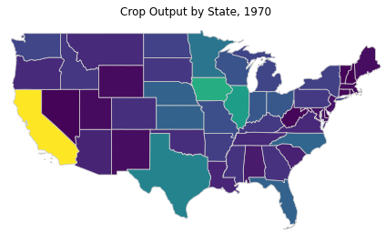
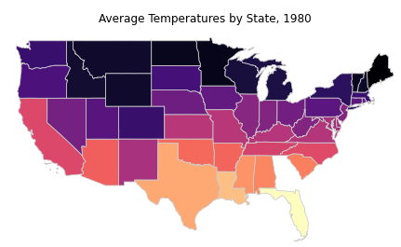
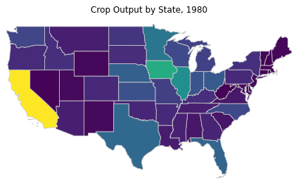
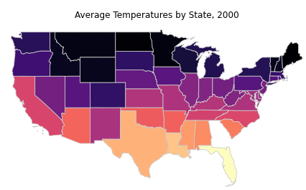
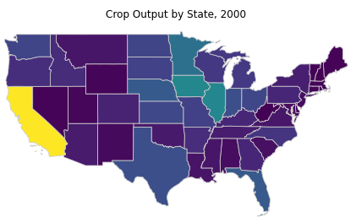
Data Analysis
Average Temperature (Quantile)
Crop Output (Quantile)
Notes:
Want to be able to answer the question: How does temperature as a proxy indicator of climate change impact agricultural production in the U.S.? If it does impact production, how does this differ between states?
For example, does the decrease in production in one state push production to other neighboring states? Does the increase in production require more land and thus also push production to neighboring states?

Slide 16
Final Steps
Finish analyses for other variables (pesticide and energy use)
Finish analyses for remaining top three agricultural states
Bivariate choropleth maps of average temperature changes and overall crop output by state over time
Other ideas for visualization? Time series?

Slide 17
Challenges
Raster data – inexperience with raster analysis, especially when analyzed alongside vector data.
Inconsistent spatial/areal units – just need to reconcile in the best way possible: considering data availability, data usability and quality, and consistency (selected top agricultural states).
Time series analysis across multiple states.
There are a lot of other factors at play that aren’t accounted for in this analysis – for example, policy.
Climate change affects different states differently, depending on their climate profile. Thus, the interactions seen in one state may not apply to another.

Slide 18
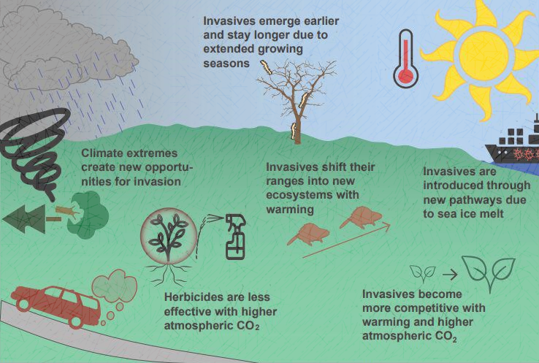
Questions?
Notes:
"Regional Invasive Species & Climate Change Management Challenge: Doubl" by Bethany A. Bradley, Evelyn M. Beaury et al. (umass.edu)

